Slide 1
INFOTRIXS Cloud(AWS) Week -1 Task

Slide 2
❖ Description:- - For monolithic : 1 EC2 instance, deploy wordpress and MYSQL on the same instances - For microservices: 2 EC2 instance, 1 for wordpress and 1 for MYSQL - Configure the necessary security group for the instances - EC2 instance type: t2-micro, AMI: ubuntu-* ❖ Create a welcome page in wordpress that will be the homepage
Task: Deploy application in monolithic and microservices architecture

Slide 3
Prerequisites for Monolithic architecture
Ec2- instances with ubuntu OS.
Wordpress : Apache2 and Php must be installed.
Mysql server.
Associating the Mysql data to wordpress application.

Slide 4
Brief explanation of monolithic architecture
Launch an EC2 instance with t2-micro type and Ubuntu AMI.
Configure security groups to allow necessary traffic.
Install and configure MySQL on the same instance.
Install and configure WordPress on the same instance.
Demonstrate accessing the WordPress homepage

Slide 5
Creating an Ec-2 instance with AMI: Ubuntu
Open Google chrome and log in AWS console.
Open EC-2 service and Click on Launch instance
Naming the Instances name as Monolithic
Select the operating system as Ubuntu
Select instance type as t2.micro ( free tier).
Create new key pair and Security group with Https, Http, Mysql ports.

Slide 6
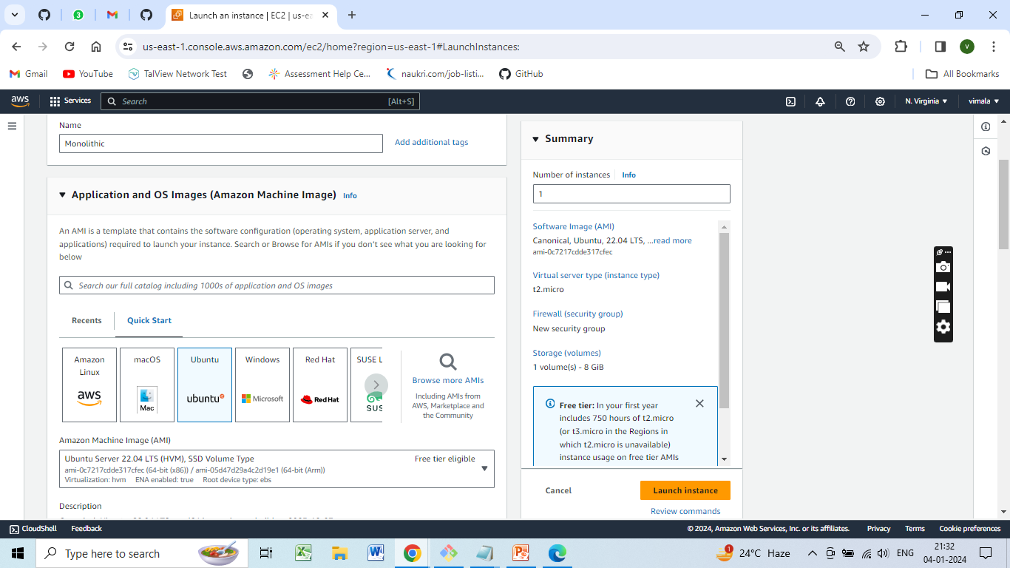
Instance Name: Monolithic AMI - ubuntu

Slide 7
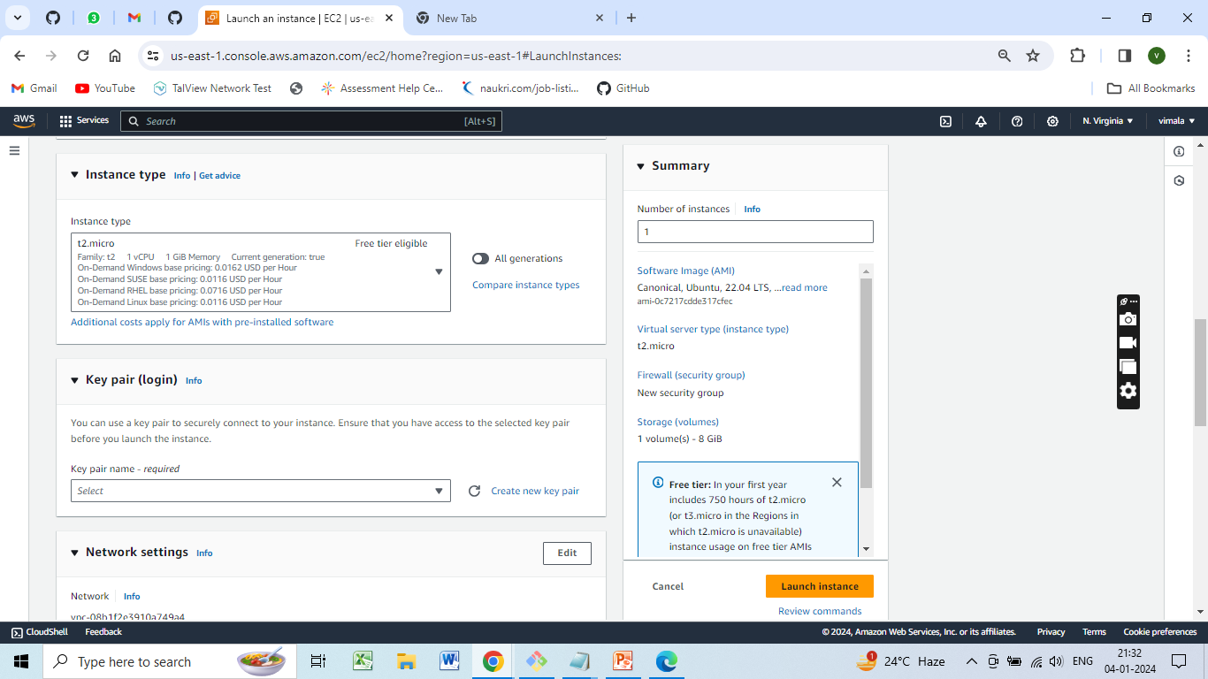
EC2 instance type: t2-micro No of Instance-1

Slide 8
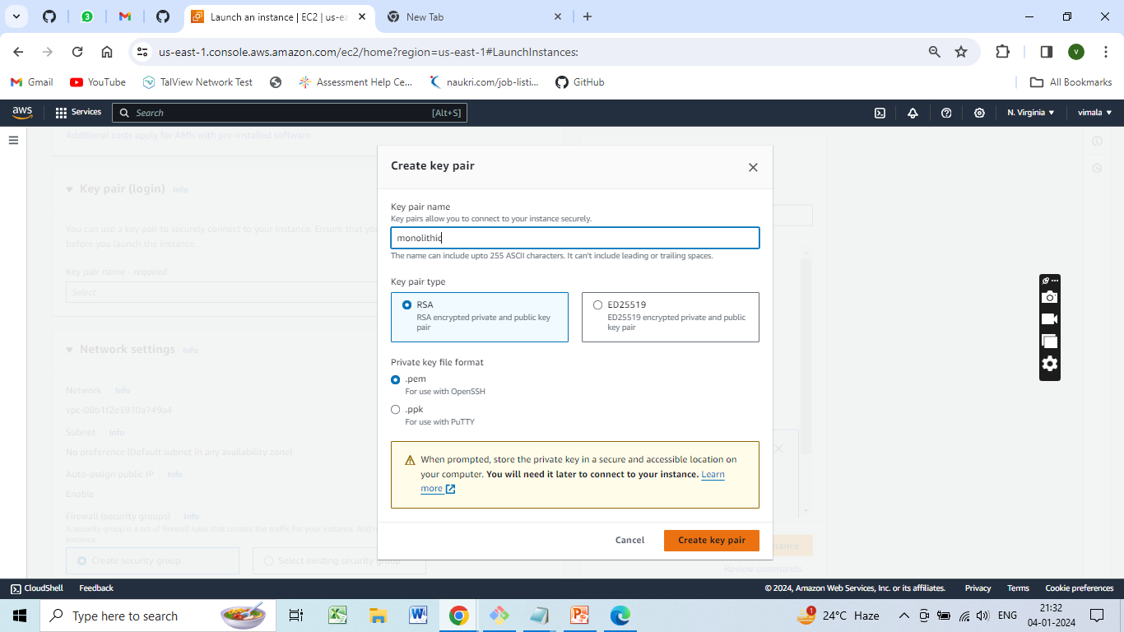
Creating new key pair

Slide 9
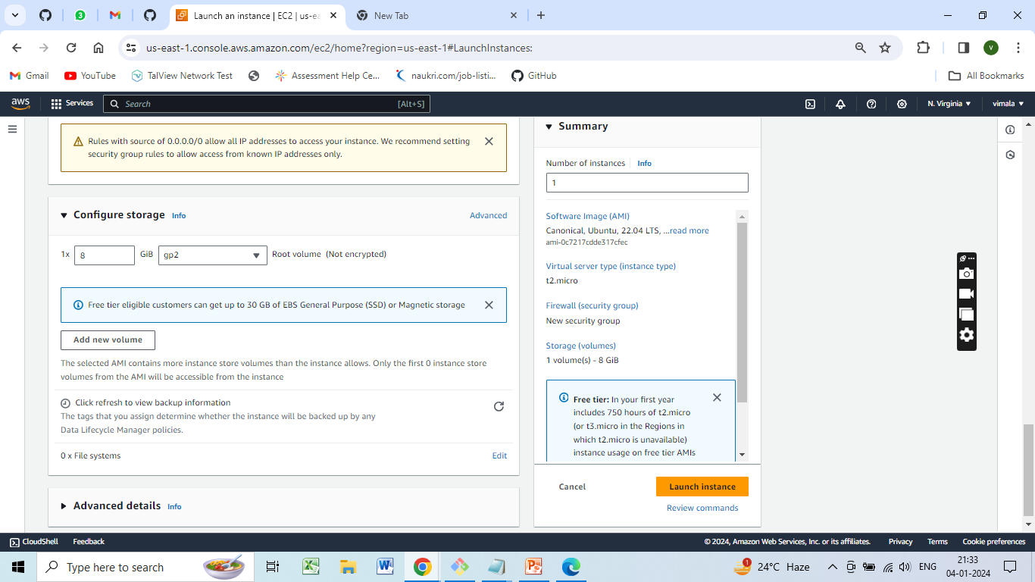
Configure Storage (volumes) 1vol - 8 GiB click on launch Instance.

Slide 10
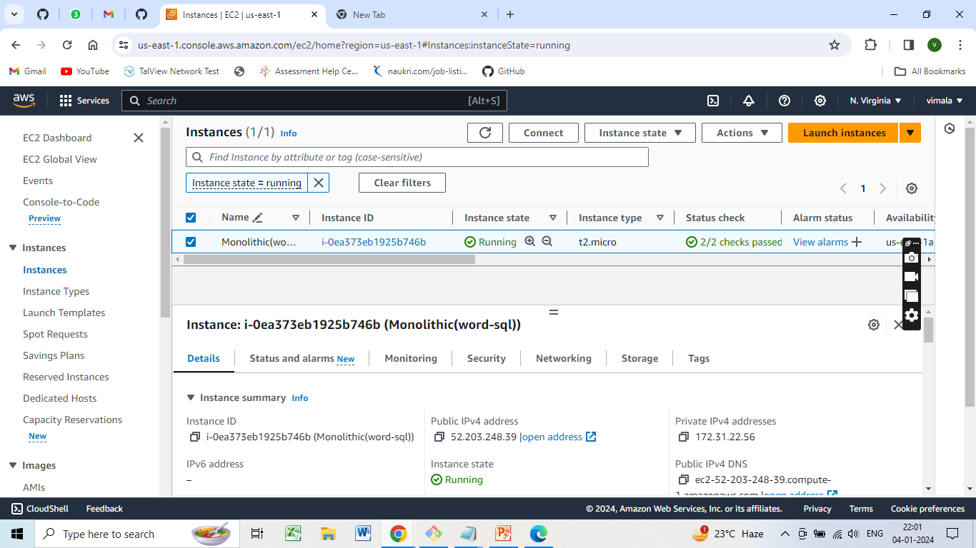
Deploying wordpress and MYSQL in same Ec-2 instances

Slide 11
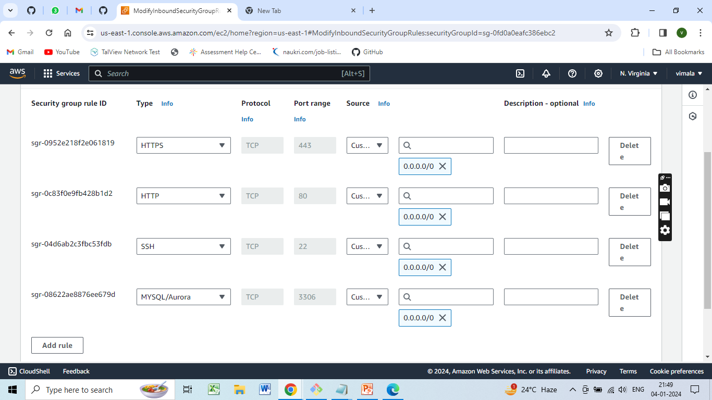
Security group with Https, Http, Mysql ports.

Slide 12
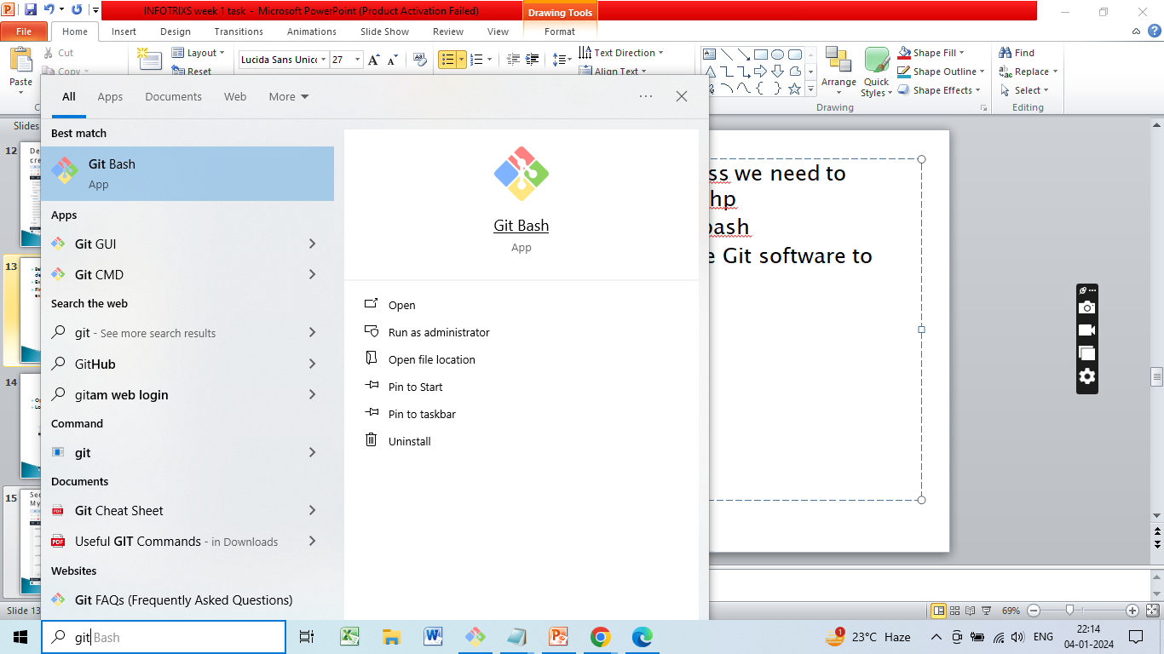
Executing the code in Gitbash
First We need to install the Git software to execute the code.
https://www.git-scm.com/download/win

Slide 13
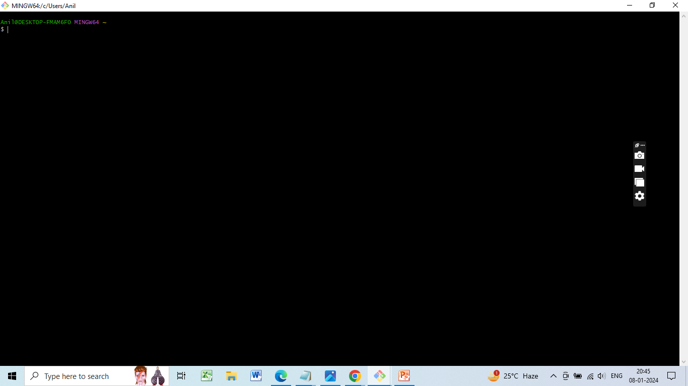
Gitbash
Open the Gitbash
Login with SSH client

Slide 14
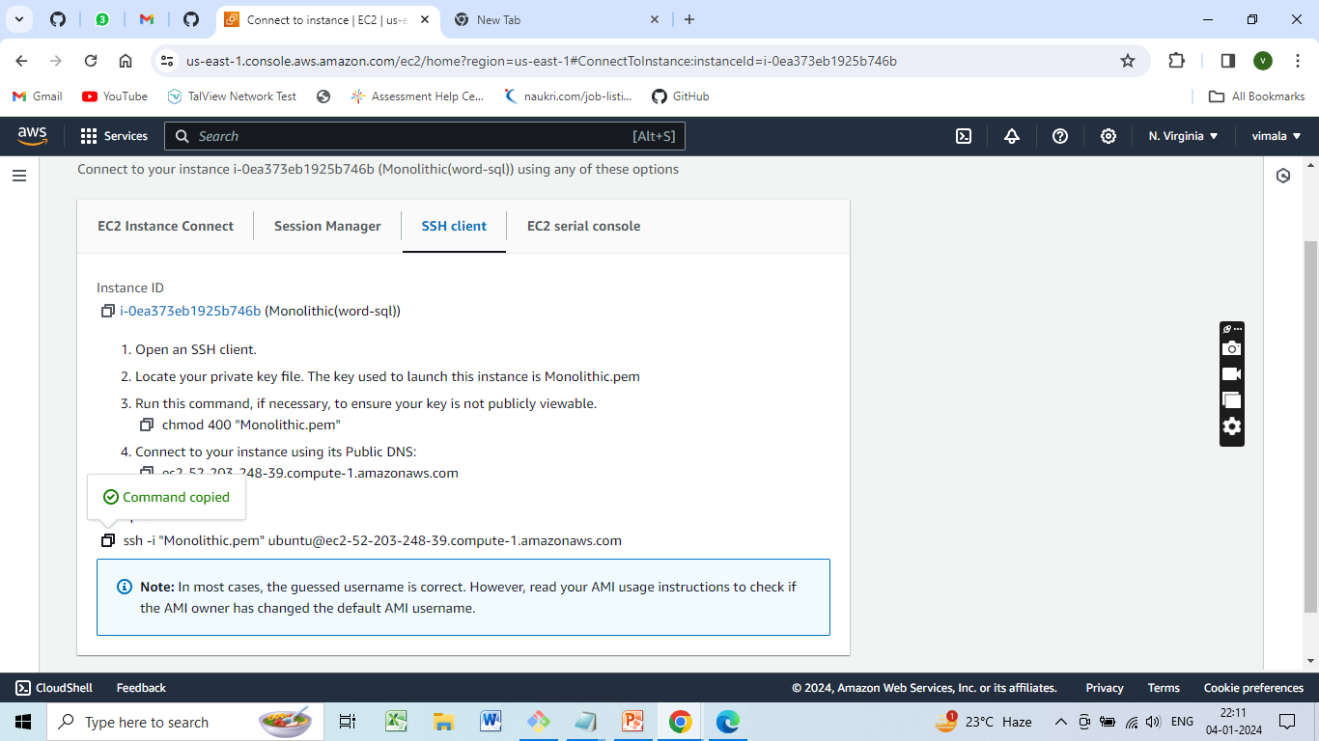
Copy the SSH Client command from Ec2 instance

Slide 15
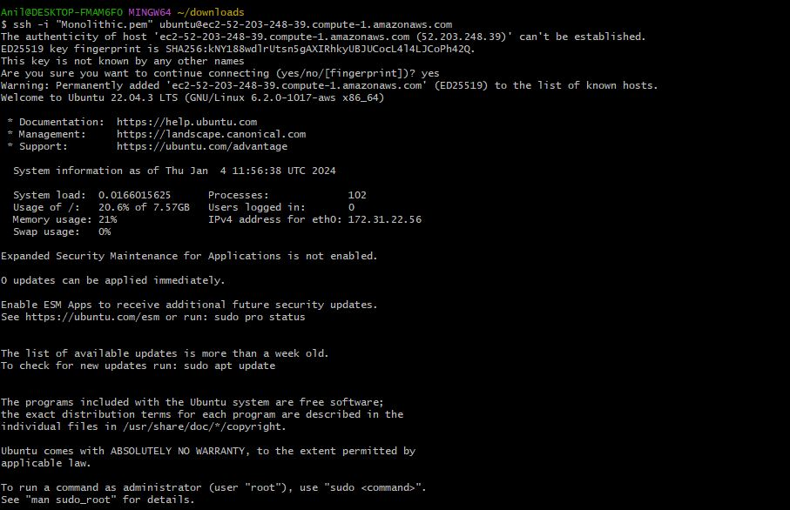
Paste SSH Client command in the Git Bash

Slide 16
Commands used for Monolithic Architechture
sudo apt update
sudo apt upgrade
sudo apt install apache2
sudo apt install php libapache2-mod-php php-mysql
sudo apt install mysql-server
sudo mysql -u root
ALTER USER 'root'@'localhost' IDENTIFIED WITH mysql_native_password by 'Vimala@123';

Slide 17
CREATE USER 'wp_user'@localhost IDENTIFIED BY 'Vimala@123';
CREATE DATABASE wp;
GRANT ALL PRIVILEGES ON wp.* TO 'wp_user'@localhost;
cd /tmp
tar -xvf latest.tar.gz
sudo mv wordpress/ /var/www/html
sudo systemctl restart apache2
cd /var/www/html/wordpress
nano “file name” –(filename: wp-config.php)

Slide 18
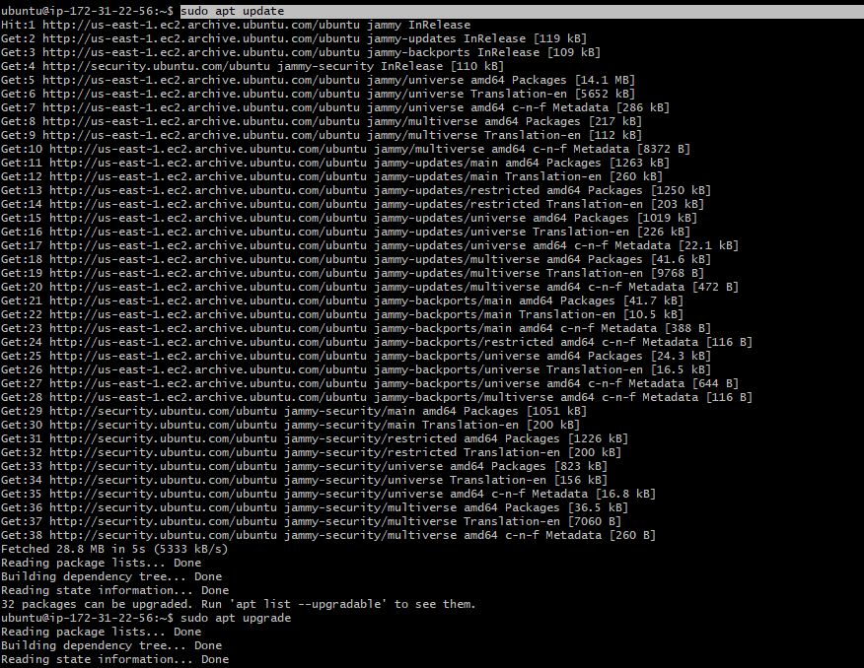
Commands execution-1. sudo apt update
The sudo apt update command is used to update the local package index and provide the system with the latest information about available packages.

Slide 19
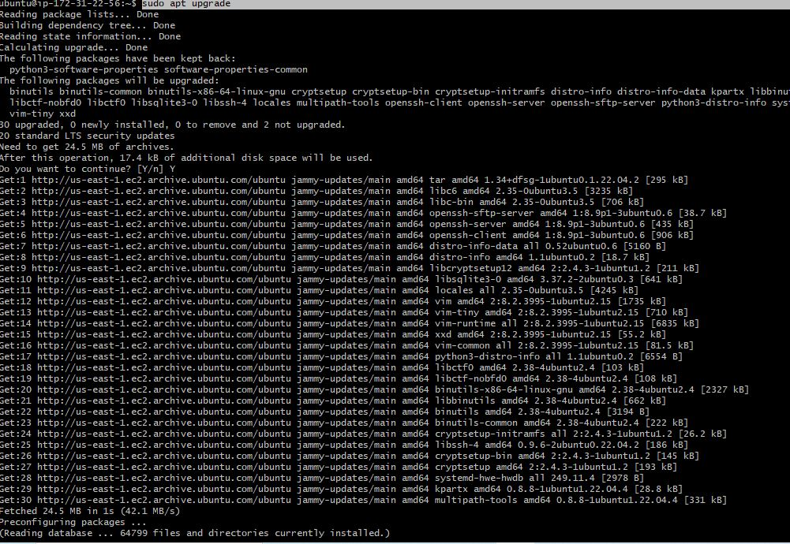
2. sudo apt upgrade
The sudo apt upgrade command downloads and installs the latest packages for a system, replacing any older versions. This command can be used to free up system memory

Slide 20
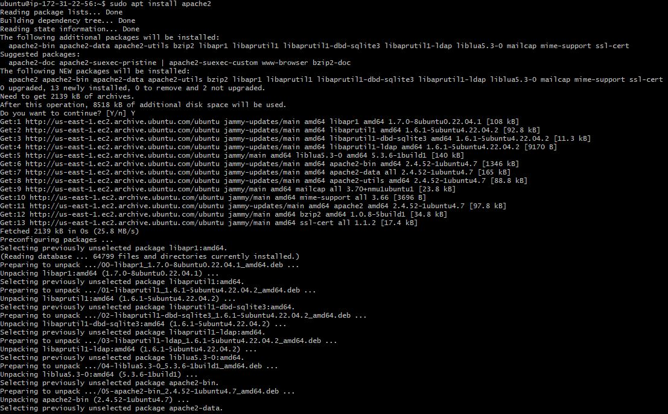
3. Install Apache sudo apt install apache2
Apache HTTP Server is a free, open-source web server software. It's the most commonly used web server on Linux systems

Slide 21
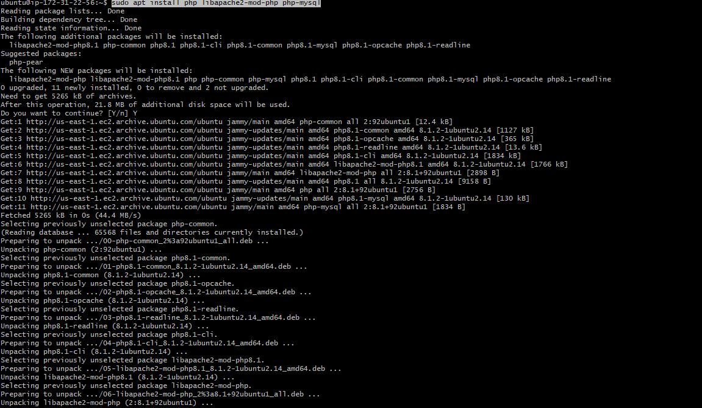
4. Install PHP sudo apt install php libapache2-mod-php php-mysql
To install core PHP packages as dependencies

Slide 22
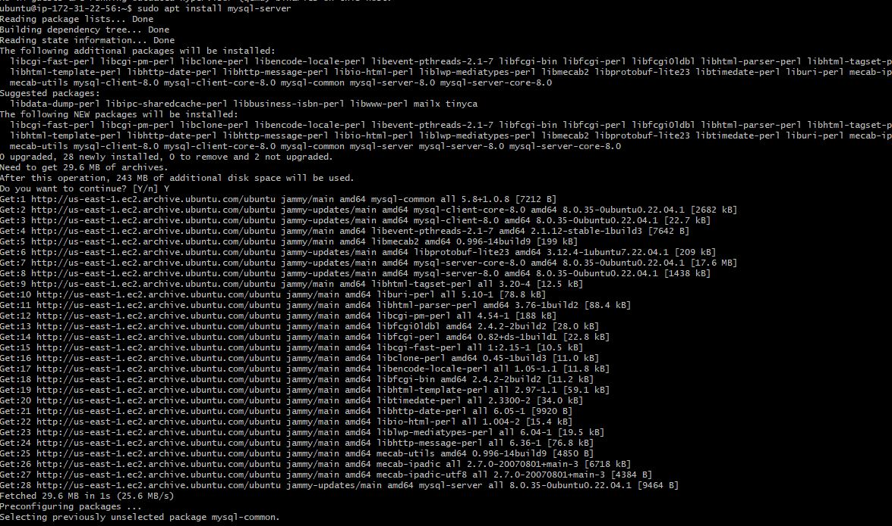
5. Install Mysql sudo apt install mysql-server
This installs the package for the MySQL server, as well as the packages for the client and for the database common files

Slide 23
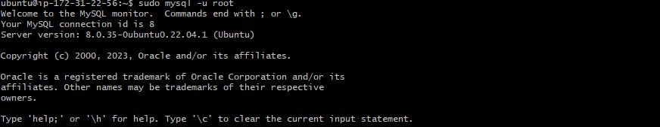
6. sudo mysql -u root
TO login IN SQL

Slide 24
7. ALTER USER 'root'@'localhost' IDENTIFIED WITH mysql_native_password by 'Vimala@123';
8. CREATE USER 'wp_user'@localhost IDENTIFIED BY 'Vimala@123';
TO create a new database user for WordPress (change the password to something strong)

Slide 25
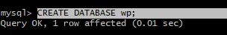
9. CREATE DATABASE wp;
10. GRANT ALL PRIVILEGES ON wp.* TO 'wp_user'@localhost;
Grant all privilege on the database 'wp' to the newly created user
USE crtl+d to exit from Mysql terminal
11.cd /tmp – creates a temporary file

Slide 26
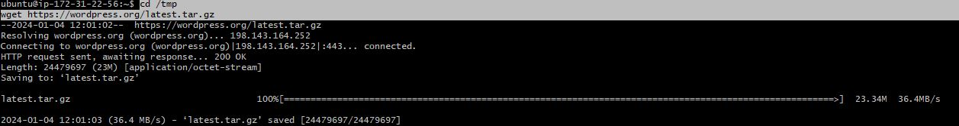
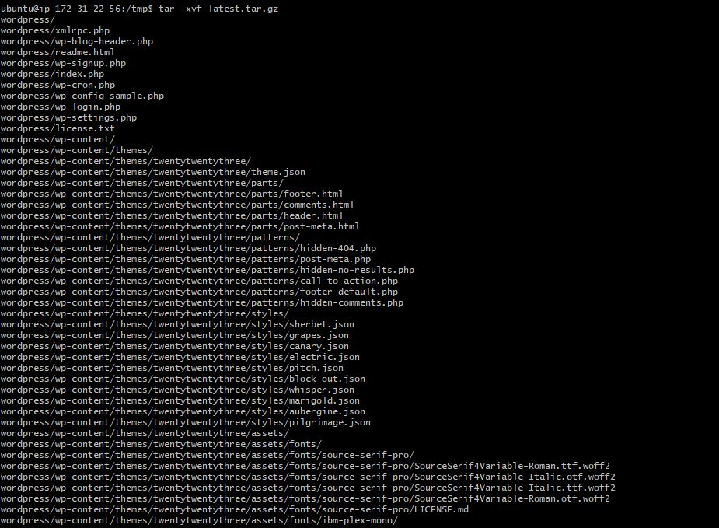
11. Download Wordpress wgethttps://wordpress.org/latest.tar.gz
TO download WordPress ZIP File
12. tar -xvf latest.tar.gz
To unzip file

Slide 27
13. sudo mv wordpress/ /var/www/html
TO Move wordpress folder to apache document root
14. sudo systemctl restart apache2
Command to restart/reload apache server

Slide 28
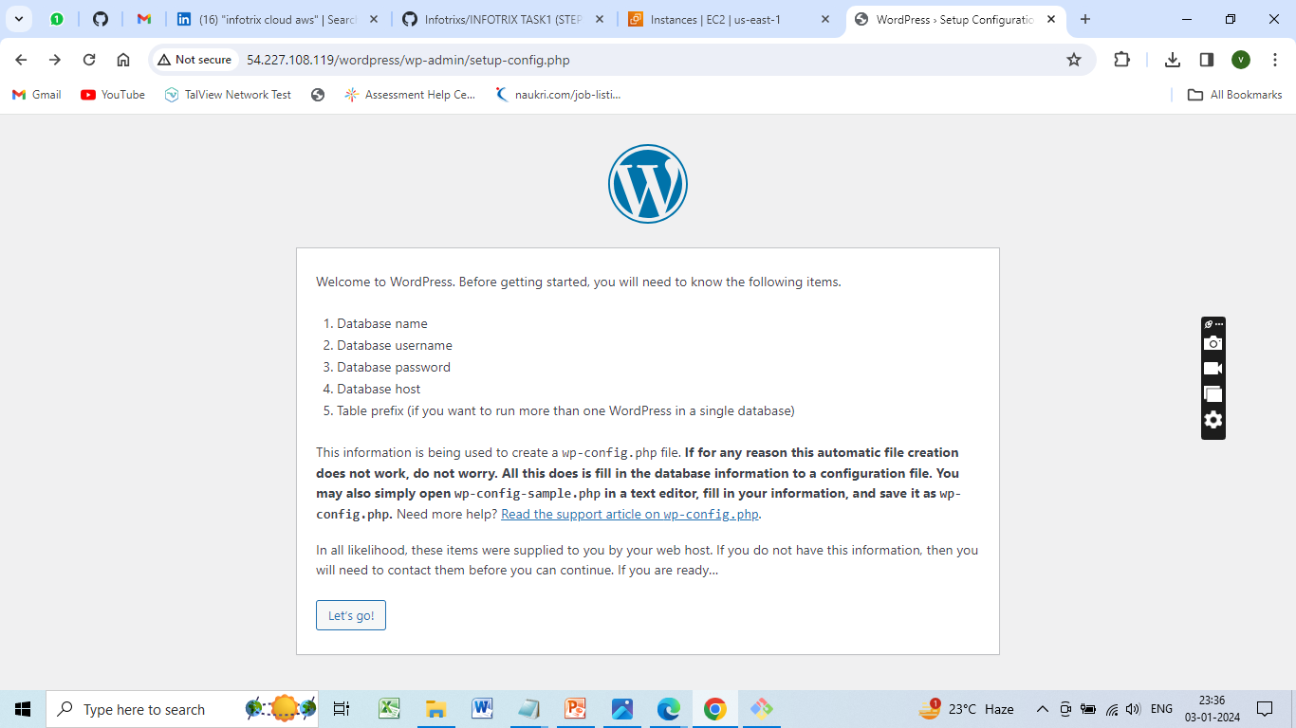
NOW for testing purpose copy the IP address of your instance and paste it in any browser in this format (http/: “instance ip address"/wordpress)
Here we can see wordpress site, enter your database name, username and password

Slide 29
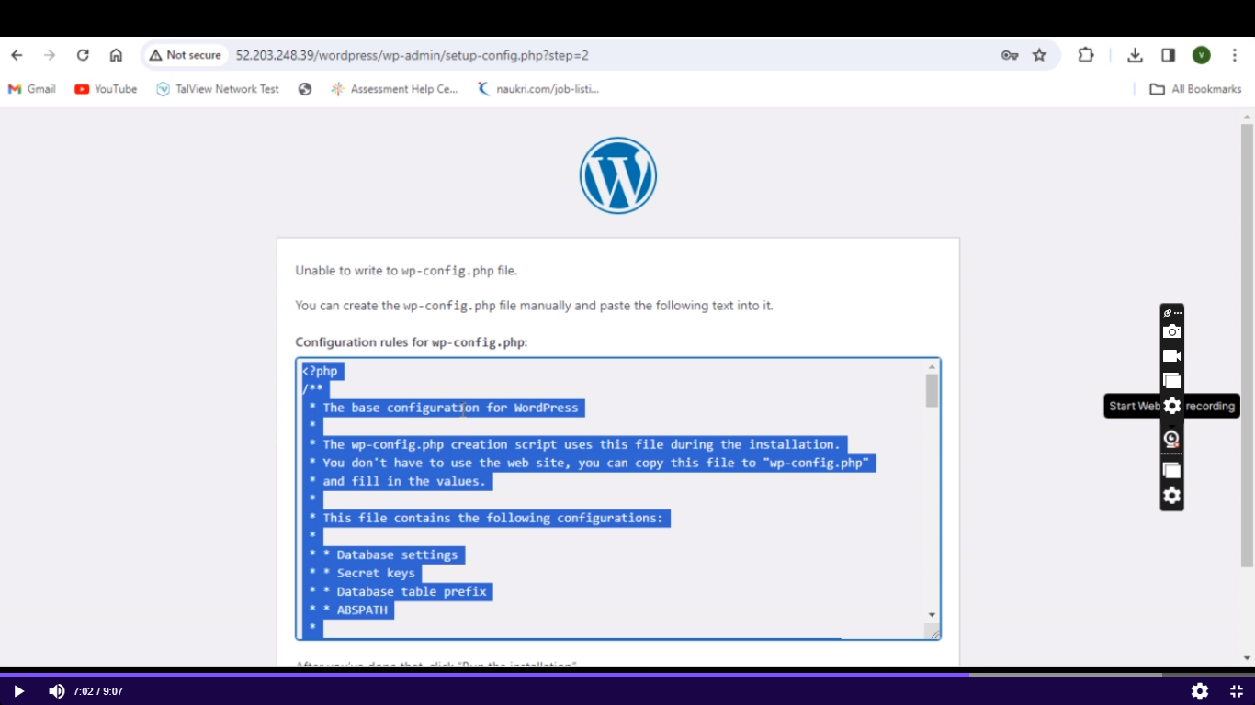
file by name wp-congig.php edit the file
copy and paste entire content in file called wp-config.php

Slide 30
15. cd /var/www/html/wordpress
16. Creating a new file nano “file name” (filename-wp-config.php)

Slide 31
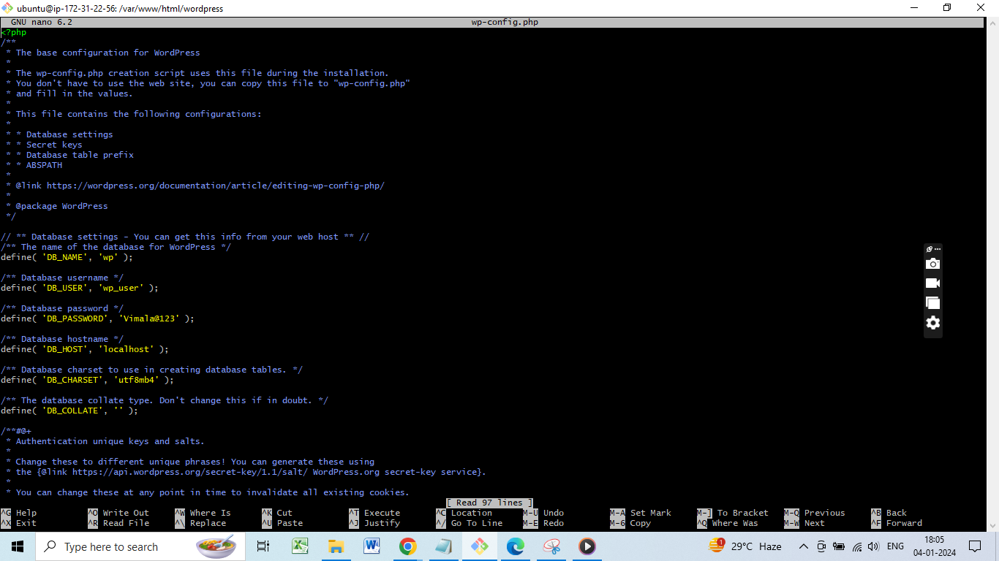
nano wp-config.php
we have to copy and paste entire content as seen in wordpress dialogue box
wp-config.php
For saving this file use ctrl+o, HIT Enter, ctrl+x, hit enter

Slide 32
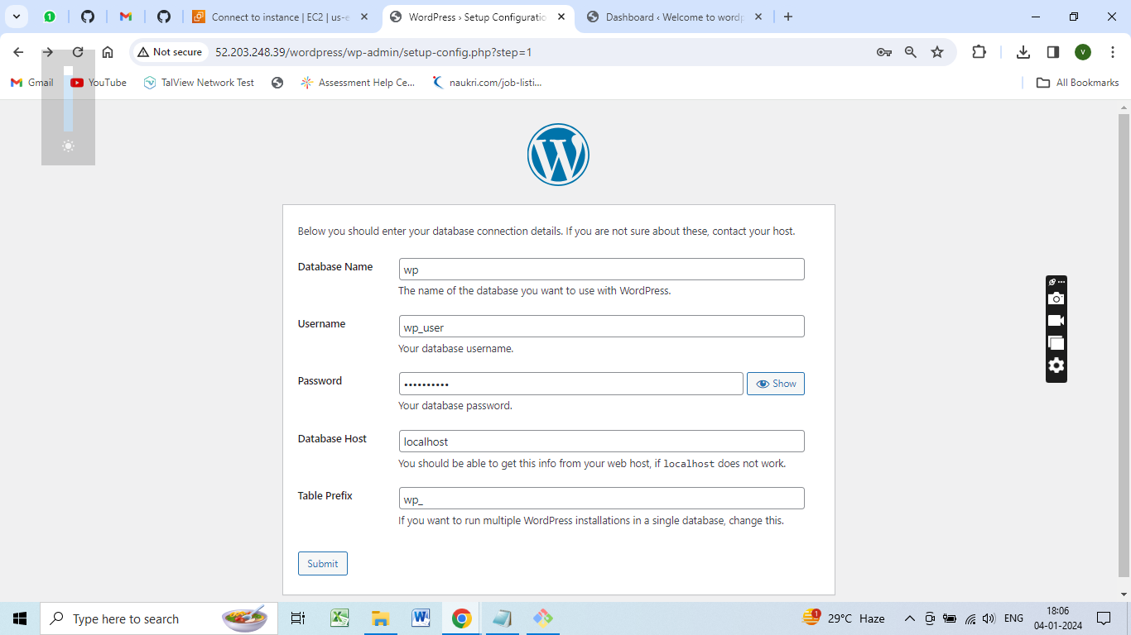
Open the webpage of the Wordpress and enter all the details of the database click on submit and run it

Slide 33
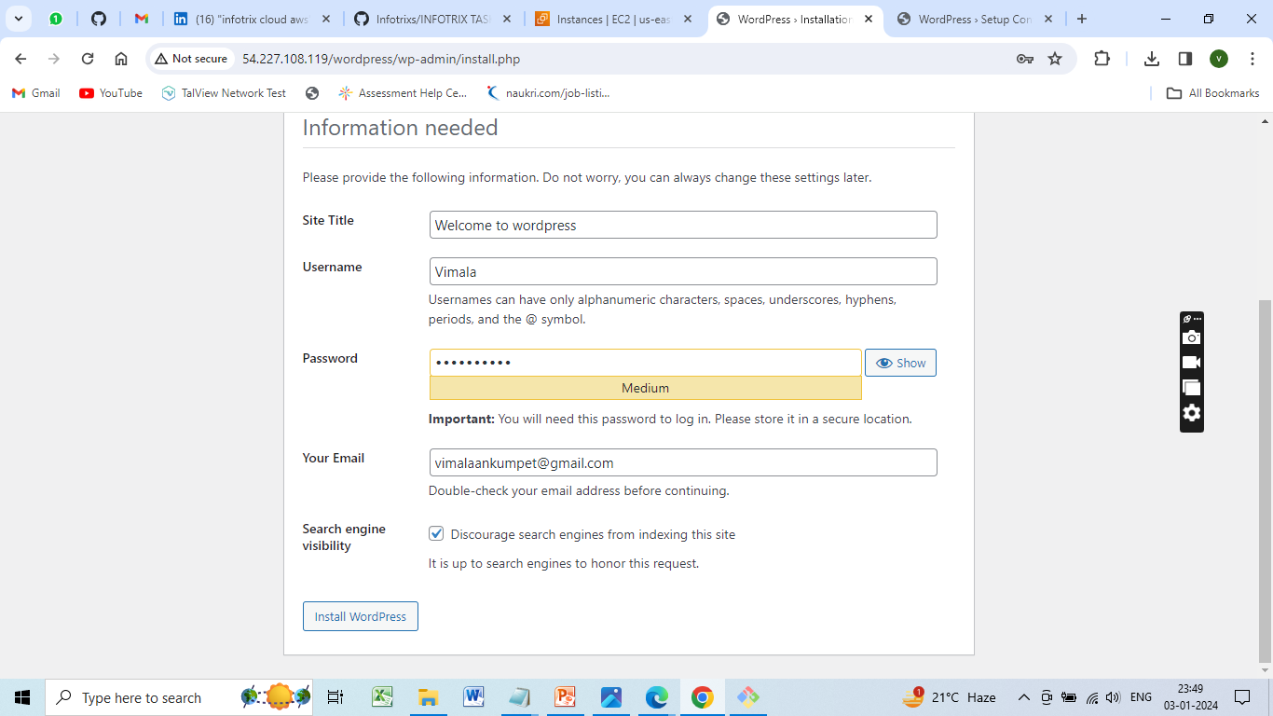
Enter all the details click on install wordpress

Slide 34
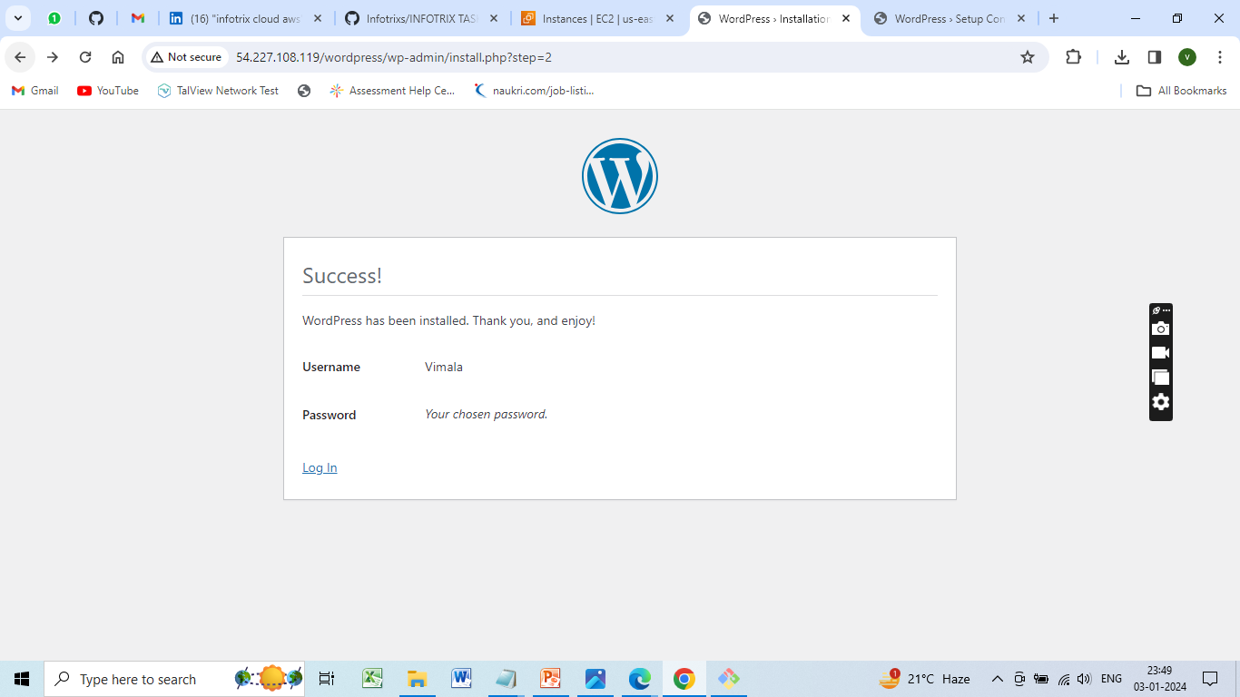
Wordpress Installed Sucessfully

Slide 35
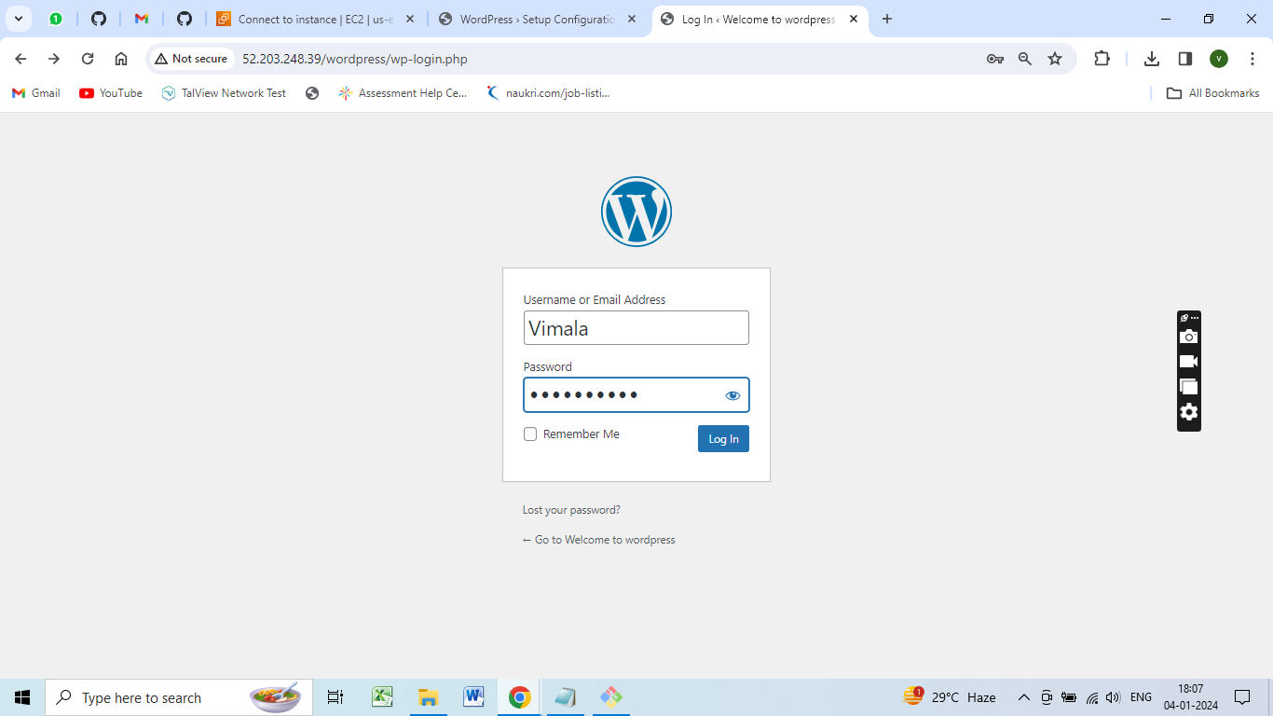
WORDPRESS LOGIN

Slide 36
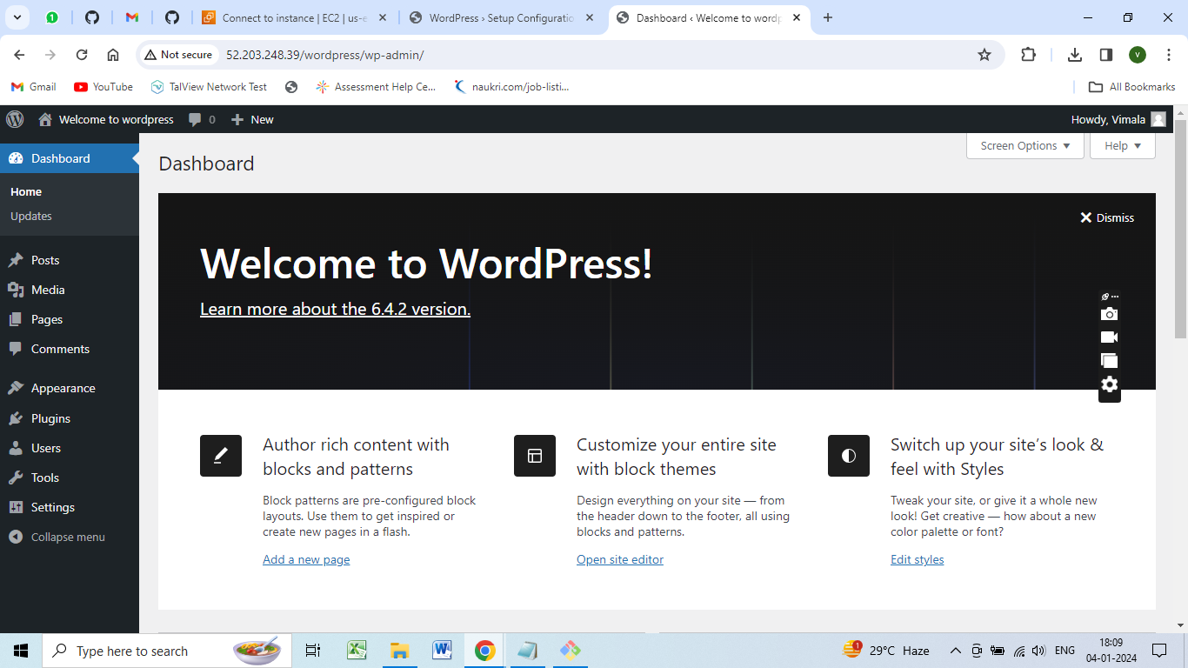
Welcome page in Wordpress

Slide 37
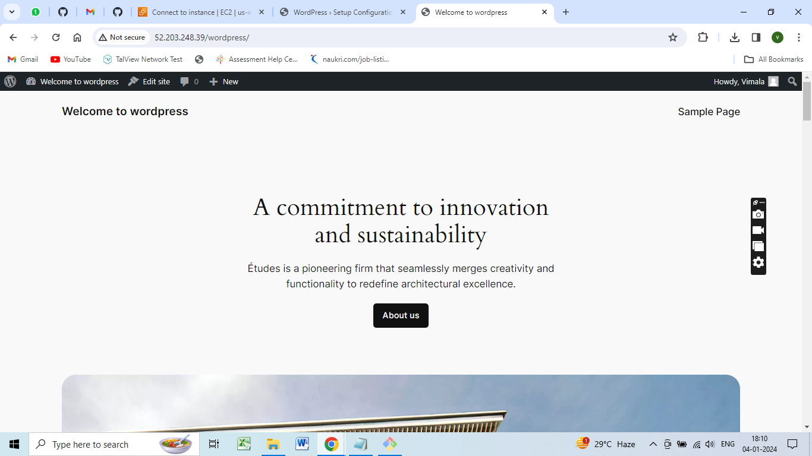

Slide 38
Microservices Deployment:
Launch two EC2 instances with t2-micro type and Ubuntu AMI.
Configure security groups for each instance to allow necessary traffic.
Install and configure MySQL on one instance.
Install and configure WordPress on the other instance.
Demonstrate accessing the WordPress homepage.

Slide 39
Commands for Microservices Architechture
sudo apt-get update
sudo apt-get install mysql-server
sudo mysql_secure_installation
sudo apt-get update
sudo apt-get install apache2 php mysql-client php-mysql libapache2-mod-php
sudo systemctlrestart apache2

Slide 40
ALTER USER 'root'@'localhost' IDENTIFIED WITH mysql_native_password by 'Vimala@123';
CREATE USER 'wp_user'@localhost IDENTIFIED BY 'Vimala@123';
CREATE DATABASE wp;
GRANT ALL PRIVILEGES ON wp.* TO 'wp_user'@localhost;
cd /tmp
wget https://wordpress.org/latest.tar.gz
tar -xvzf latest.tar.gz

Slide 41
sudo mv wordpress/* /var/www/html/
sudo systemctl restart apache2
cd /var/www/html/wordpress
nano wp-config.php
define('DB_NAME', 'your_database_name'); • define('DB_USER', 'your_database_user'); • define('DB_PASSWORD','your_database_password');
sudo systemctl restart apache2

Slide 42
sudo apt update
sudo apt install mysql-server
sudo systemctl status mysql
sudo mysql
ALTER USER 'root'@'localhost' IDENTIFIED WITH mysql_native_password BY ‘Vimala@123';
CREATE DATABASE mysql_test; USE mysql_test; CREATE TABLE table1 (id INT, name VARCHAR(45)); INSERT INTO table1 VALUES(1, 'INFOTRIXS'), (2, 'CLOUD'), (3, 'DEVOPS'), (4, ‘VIMALA');
SELECT * FROM table1

Slide 43
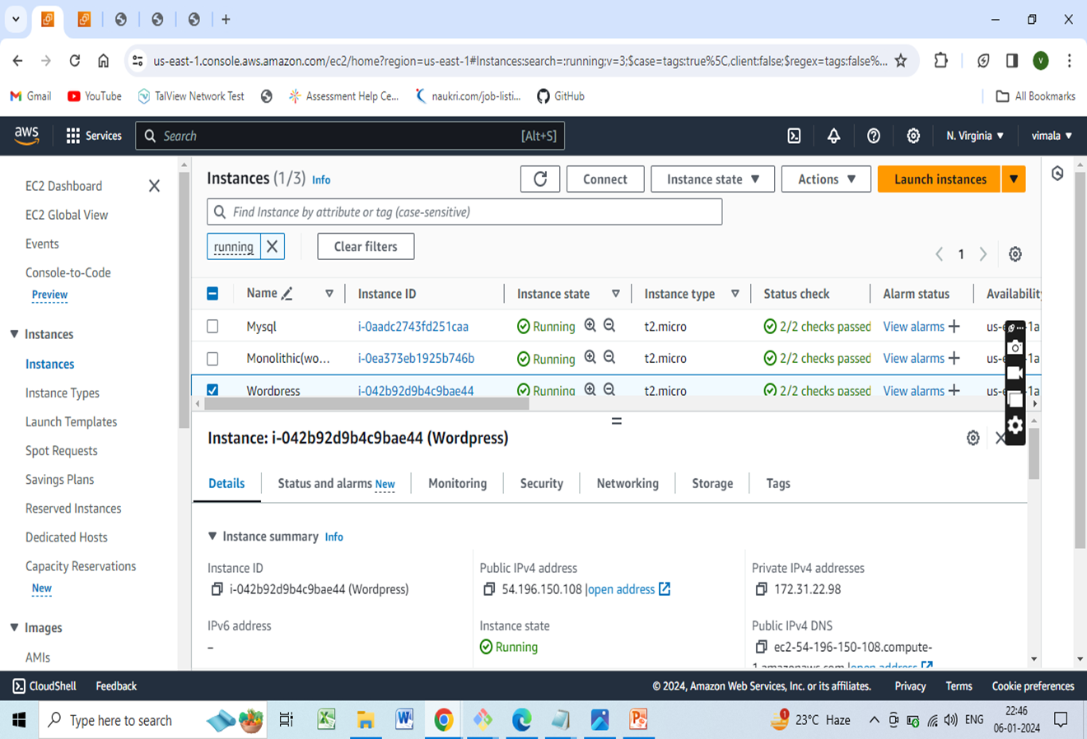
Deploying wordpress and MYSQL in Different Ec-2 instances

Slide 44
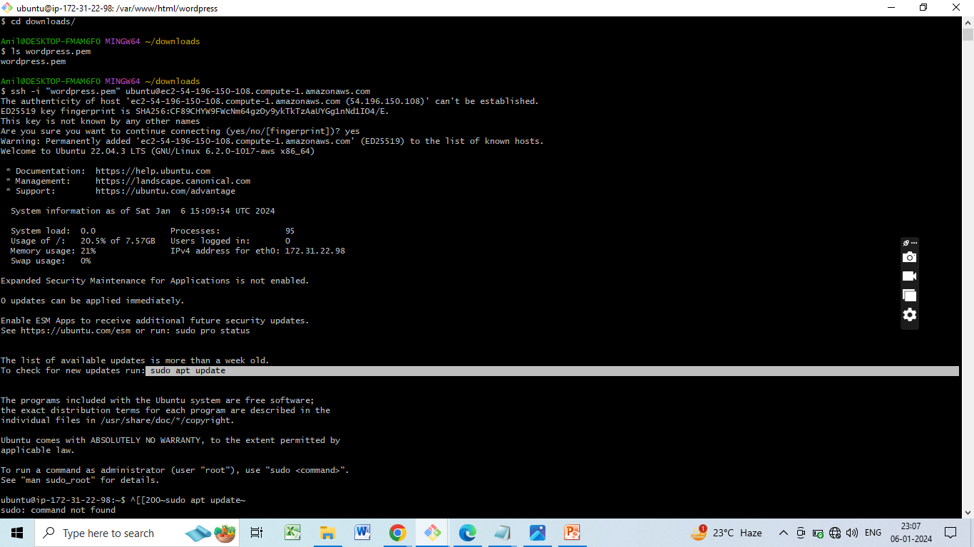
Sudo apt update

Slide 45
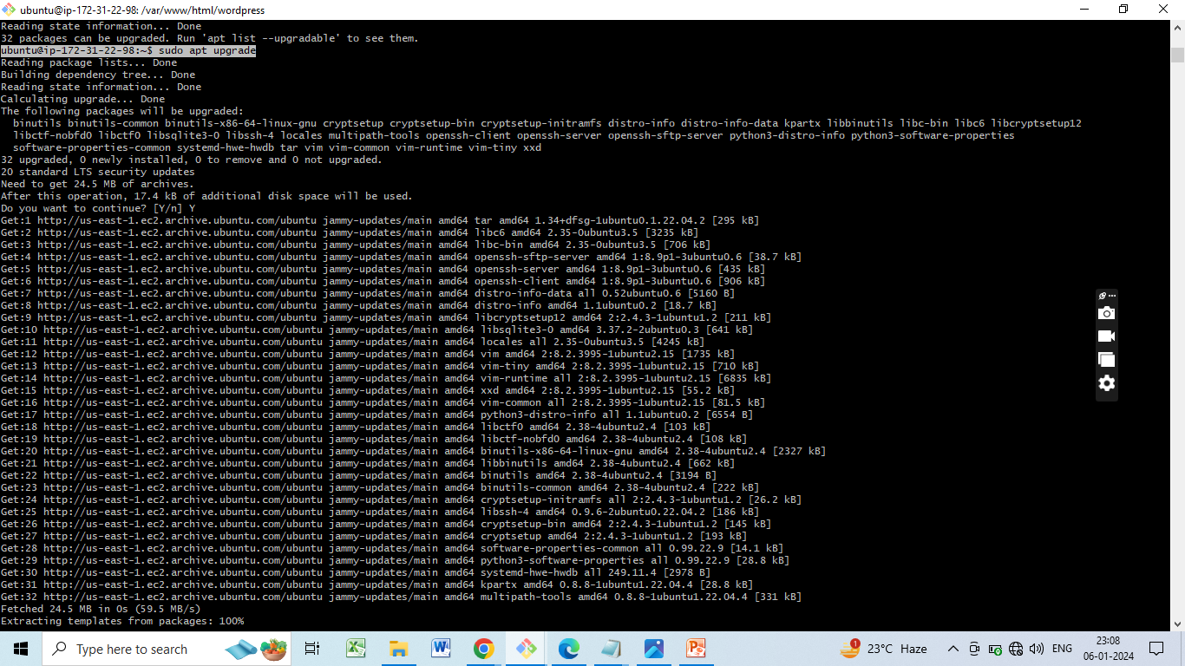
sudo apt upgrade

Slide 46
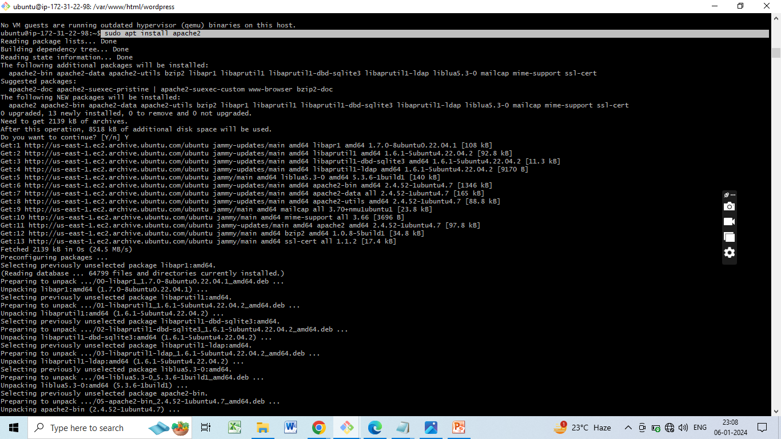
Installing Apache

Slide 47
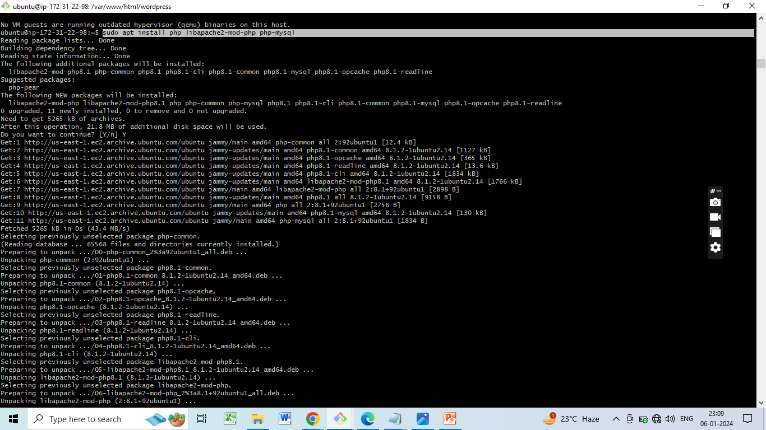
Installing PHP

Slide 48
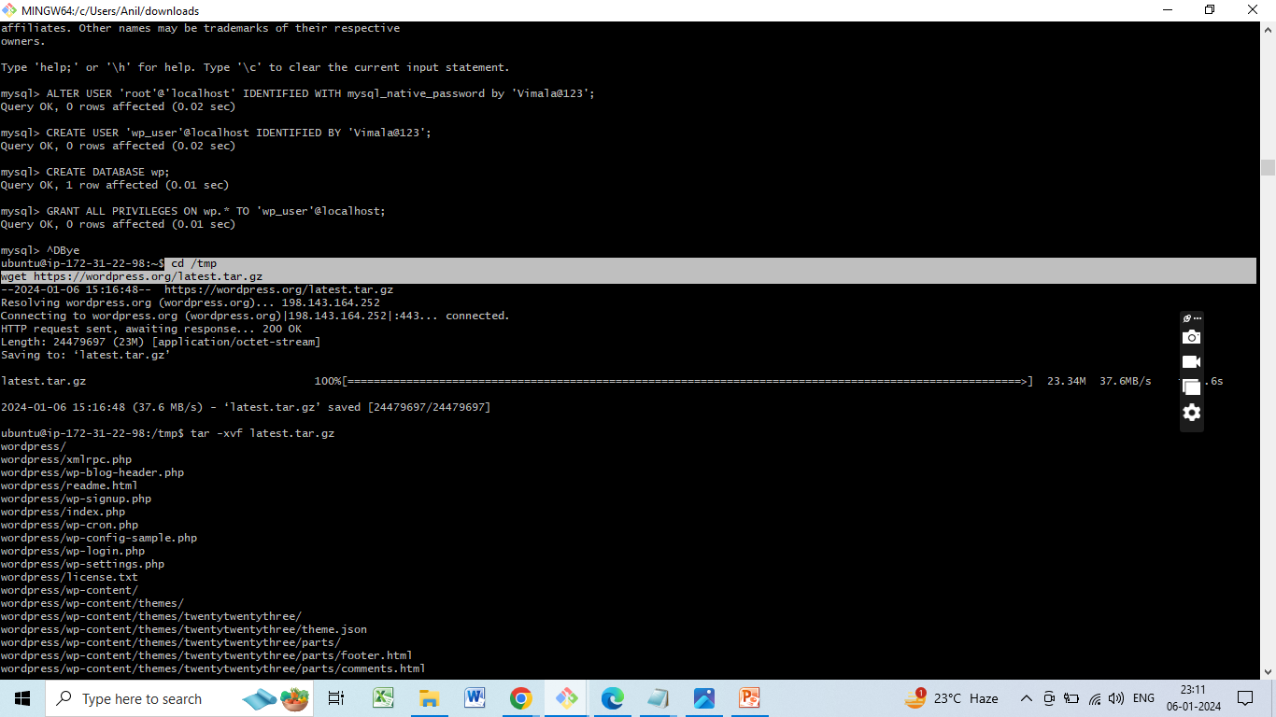
Install WordPress on WordPress EC2 Instance

Slide 49
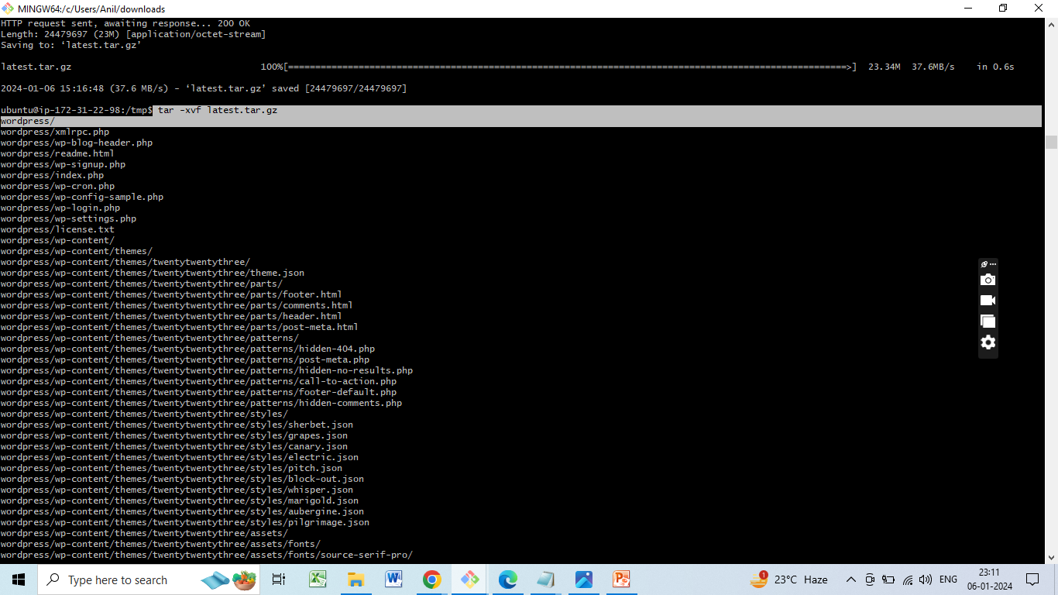
To unzip file tar -xvf latest.tar.gz

Slide 50
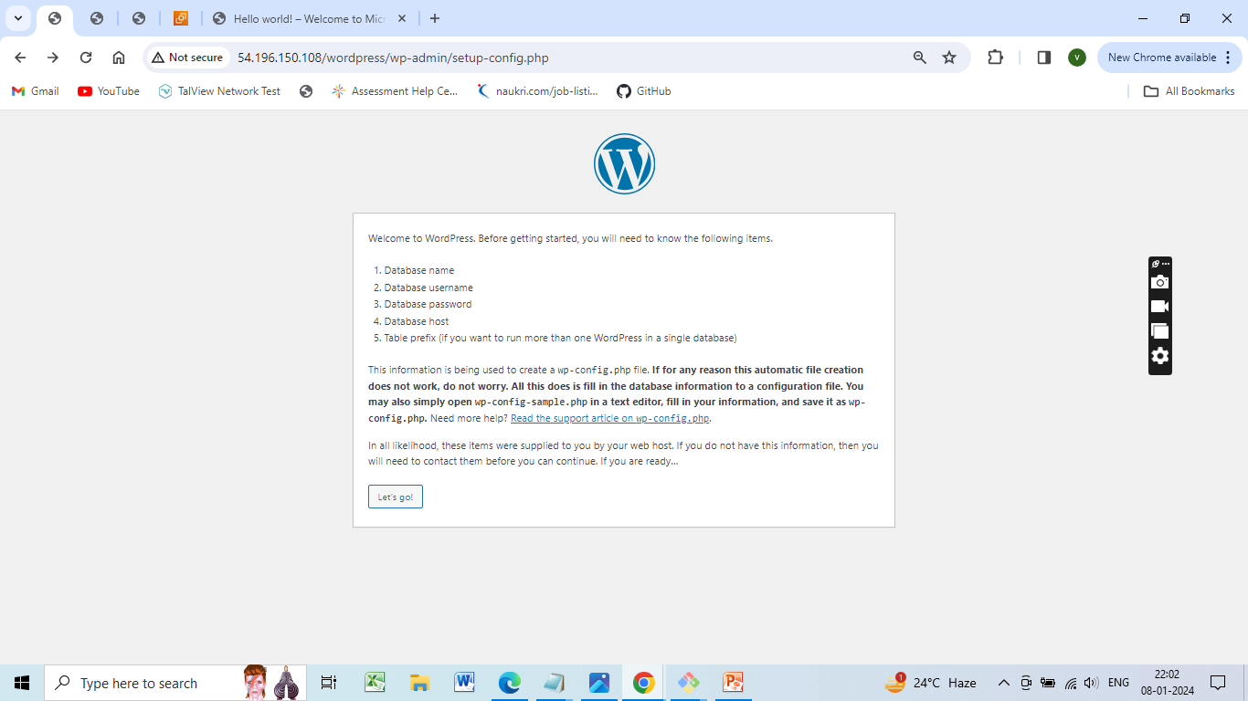
Configure and Edit wp-config.php

Slide 51
Creating a new file nano “file name” (filename-wp-config.php)
define('DB_NAME', 'your_database_name'); • define('DB_USER', 'your_database_user'); • define('DB_PASSWORD','your_database_password');
define('DB_HOST', 'localhost');
define('DB_NAME', 'wp');
define('DB_USER', 'wp_user'); define('DB_PASSWORD', 'your_password'); define('DB_HOST', 'mysql-instance-public-ip');

Slide 52
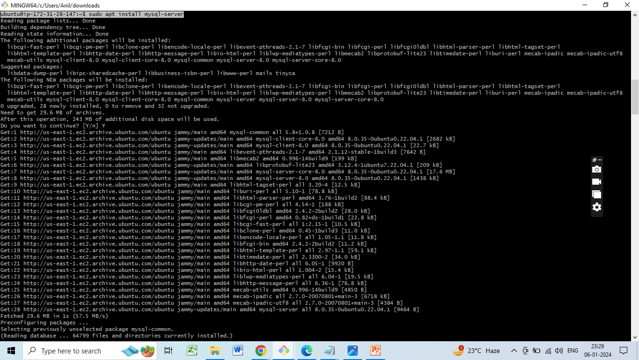
Install MySQL on MySQL EC2 Instance

Slide 53
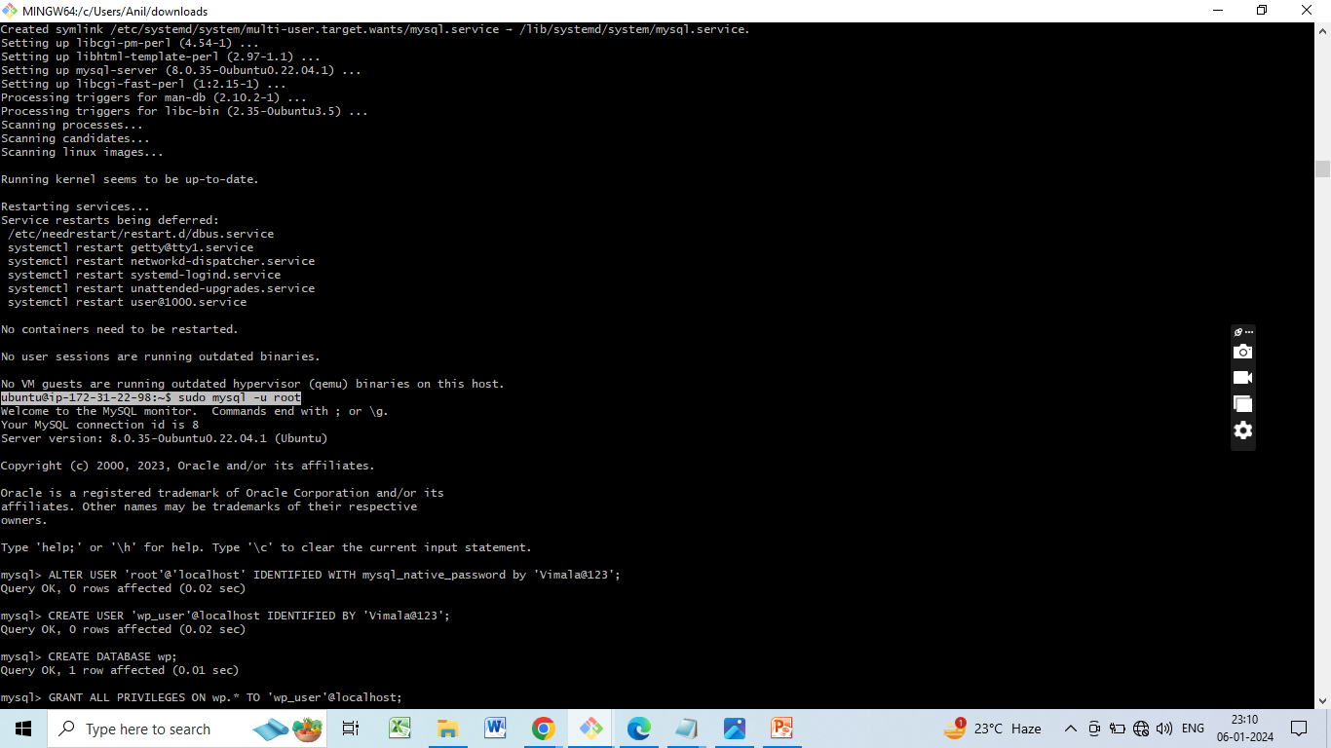
Configure MySQL Database and User

Slide 54
Connect to MySQL
mysql -u root -p
Create WordPress database and user
CREATE DATABASE wordpress;
CREATE USER 'wordpressuser'@'localhost' IDENTIFIED BY 'your_password';
GRANT ALL PRIVILEGES ON wordpress.* TO 'wordpressuser'@'localhost' WITH GRANT OPTION;
FLUSH PRIVILEGES;
EXIT;

Slide 55
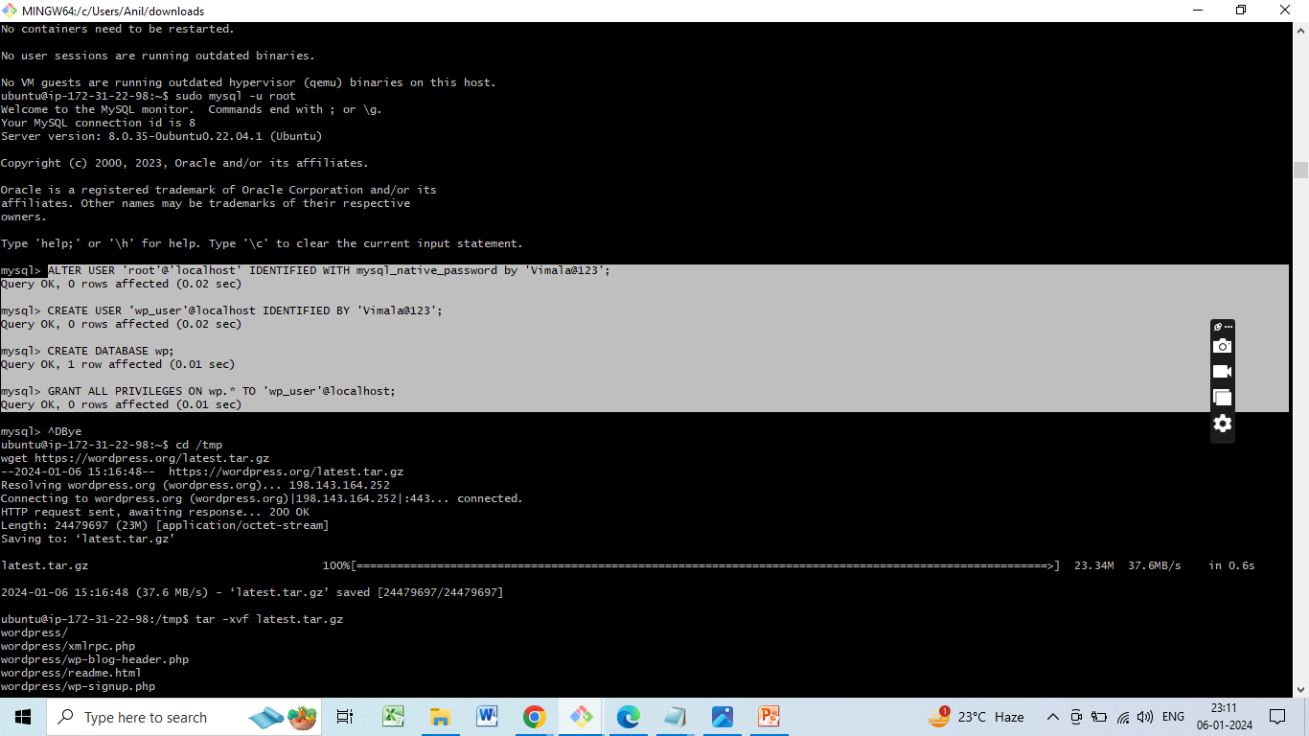

Slide 56
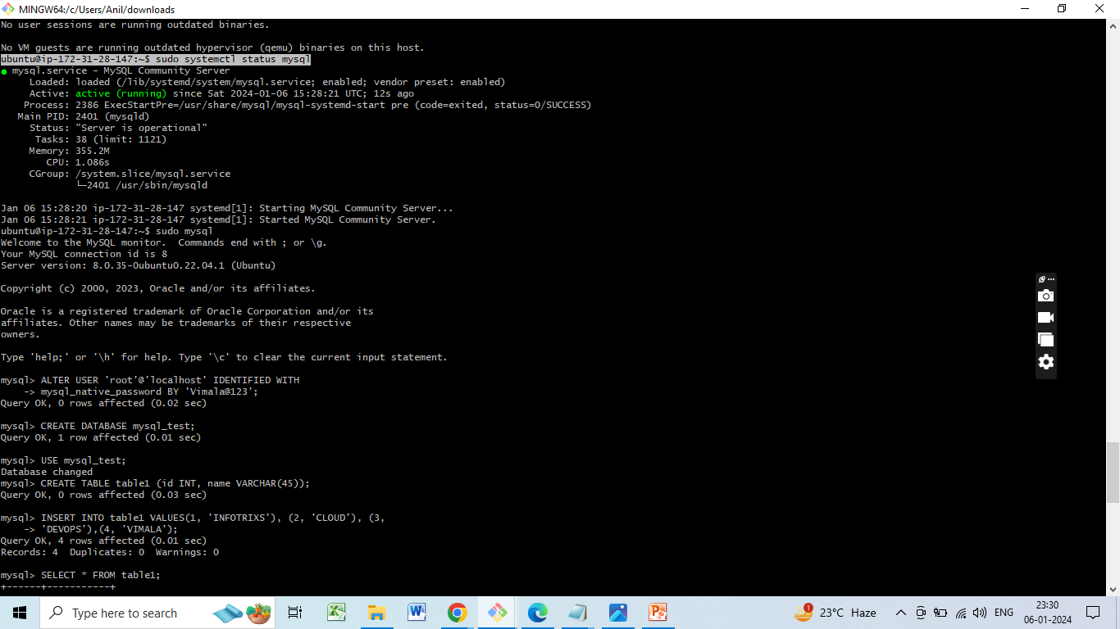
Checking Mysql status

Slide 57
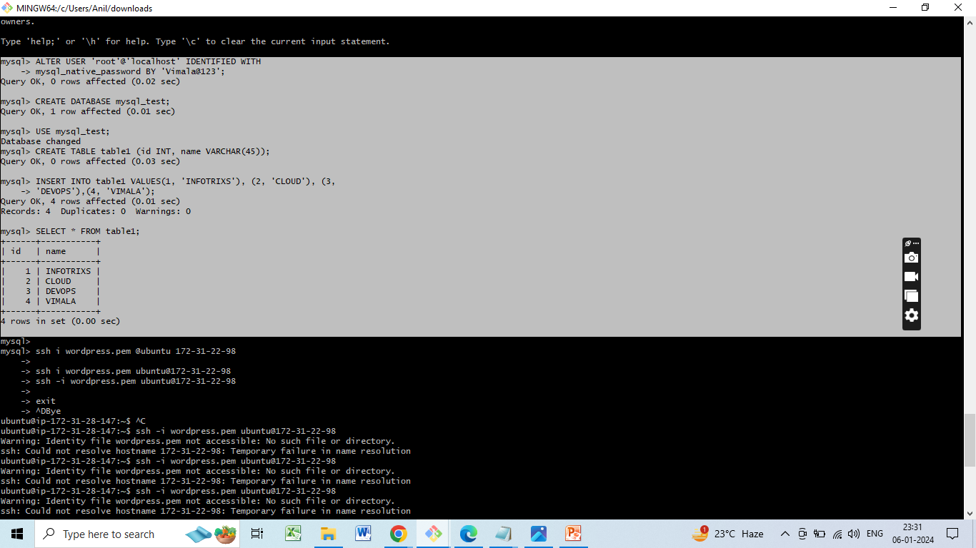
CREATE DATABASE mysql_test; USE mysql_test; CREATE TABLE table1 (id INT, name VARCHAR(45)); INSERT INTO table1 VALUES(1, 'INFOTRIXS'), (2, 'CLOUD'), (3, 'DEVOPS'), (4, ‘VIMALA'); SELECT * FROM table1

Slide 58
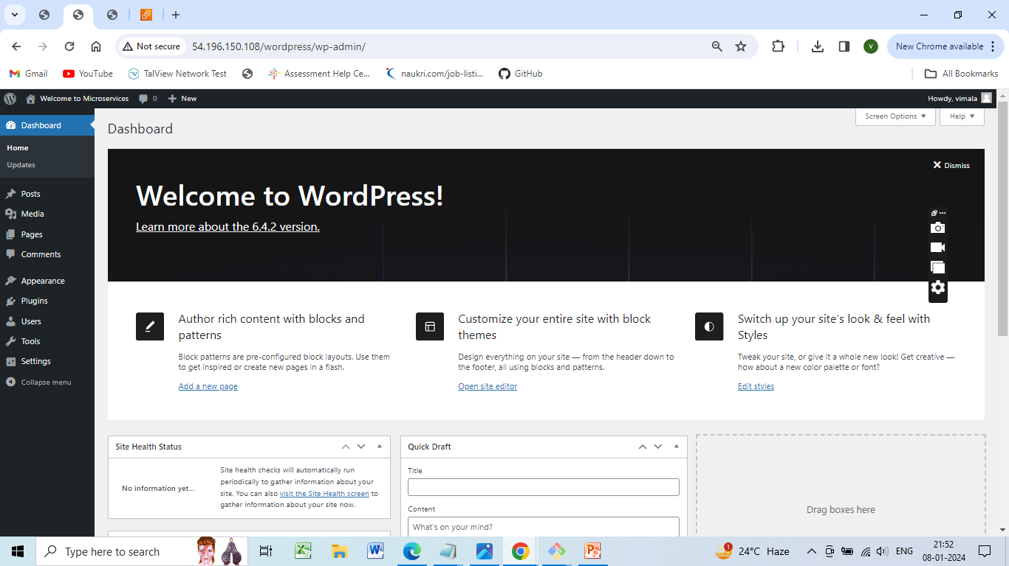
Welcome page in Wordpress

Slide 59
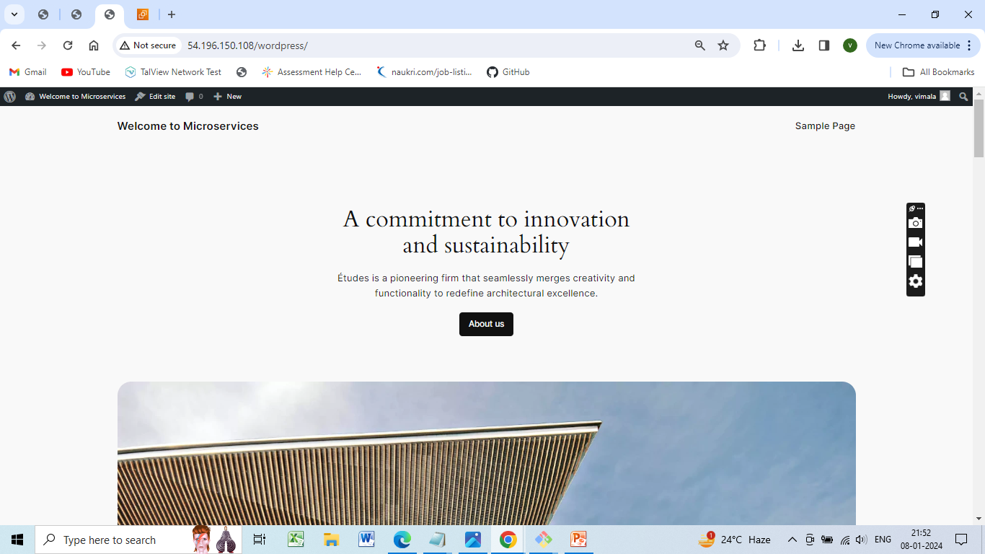

Slide 60
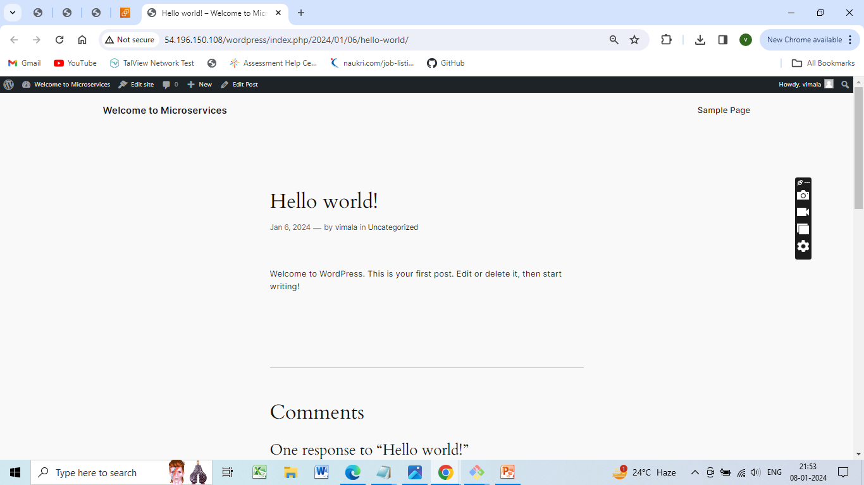

Slide 61
Conclusion
In the monolithic architecture, both WordPress and MySQL are installed on a single EC2 instance, which simplifies deployment but may lead to resource contention.
In the microservices architecture, WordPress and MySQL are separated into two instances, providing better scalability and isolation but also increasing complexity

Slide 62


